Slide 1
Comics in the Classroom
Randi Curtis, 2015 AAEA Fall Conference

Slide 2
About me
Upper School Visual Arts teacher, Pulaski Academy
Previously taught 7th-12th grade Art and Theatre in Prescott, AR
BFA in Ceramics- University of Arkansas, MA in Art Education- Boston University
MA Thesis topic: Self As Super Hero, addressed the topic of autobiography and comic books in the classroom

Slide 3
Why Comics?
Saturation in Contemporary Popular Culture
Connecting to Student Interests/Visual Culture
Adolescent Stage of Artistic Development
Vehicle for visual and verbal storytelling (LITERACY!!!)

Slide 4
Comics in Pop Culture
Comics have been around for the better part of 100 years and have exploded in popularity in recent years (Tychinski, 2015)
Movies, toys, Halloween costumes, TV shows... They are everywhere!
What used to be considered pulp… is now a part of our cultural fabric

Slide 5
Connecting to Visual Culture
Visual Culture= the way that we express our cultures through images and symbols (Freedman, 2003)
We all identify with distinct cultures, and so do our students
Students want to express themselves and their ideas
However…

Slide 6
Adolescent Stage of Artistic Development
Students in the Adolescent Stage are sometimes self-conscious about their art making skills (Graham, 2003)
They value realism, but may not yet have the skill they need to realize their ideas
Comics can bridge the gap between verbal/written and visual communication
Comics are open ended, so the pressure is decreased (Burton, 2009)

Slide 7
Storytelling and Literacy
Communication is a vital skill which can be taught through storytelling
Comics = Verbal and Visual communication working in harmony (Sousanis, 2012)
Allowing students to explore their own identities through storytelling helps them understand themselves and the world better! (McLean, 2005)

Slide 8
Where should I start?
Fiction
Fables- Bill Winningham (Fairytales and fantasy and intrigue… oh my!)
Arkham Asylum- Dave McKean Grant Morrison (gorgeous and ethereal artwork)
Batman: The Dark Knight Returns- Frank Miller (classic super hero story line)
Sandman Series- Neil Gaiman (gateway series!)
Autobiographical Comic books
Maus I & II- Art Spiegelman (WWII Historical Connection)
Persepolis I & II- Marjane Satrapi (Women’s and Iranian History!)
Blankets- Craig Thompson (teenage love and heartbreak)

Slide 9
Encouraging Creativity through Structure
There are a few key pieces that make up a comic; Students can incorporate their own levels of creativity in these components
Panels
Shape, Size, text/font, bubble style, overlap… these are all aspects that can be personalized
Gutters
Images and words don’t have to stay contained in the panels; gutters, or the space around panels, can be utlized as well.

Slide 10
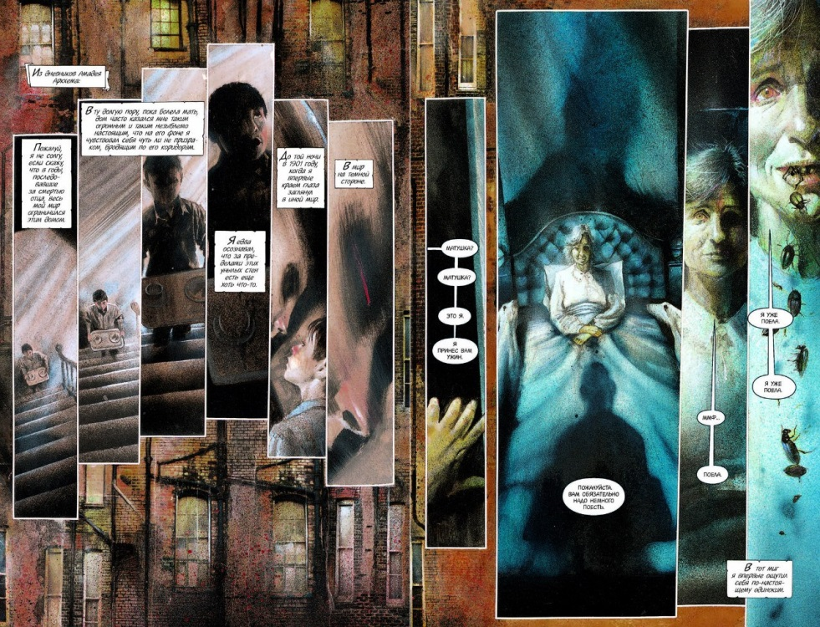
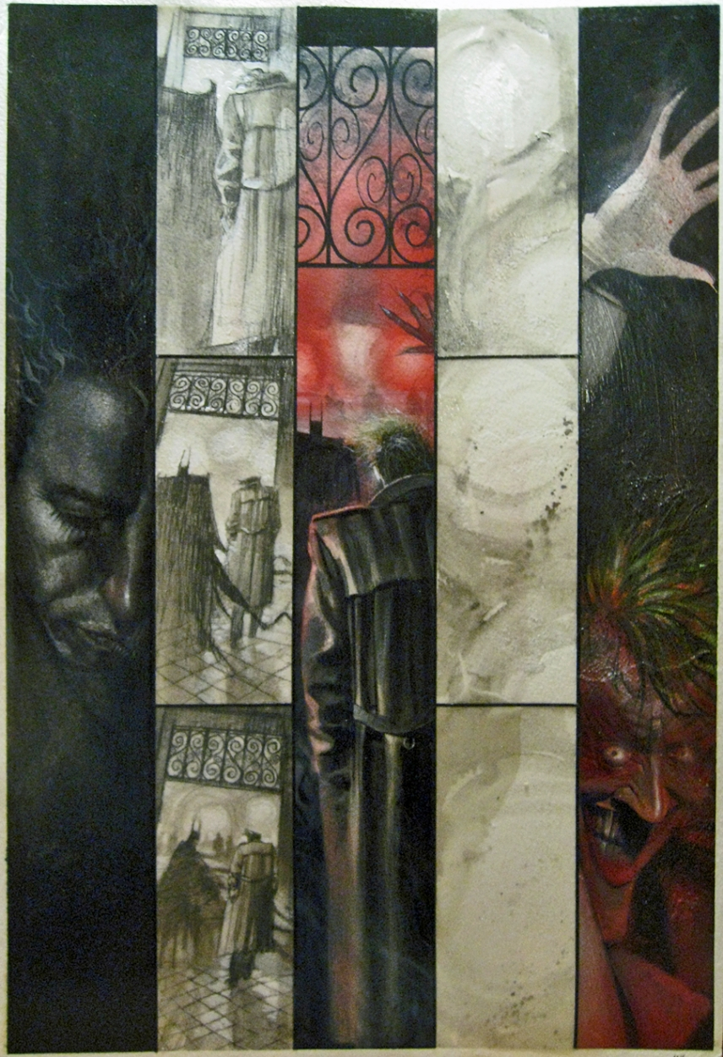
Arkham Asylum

Slide 11
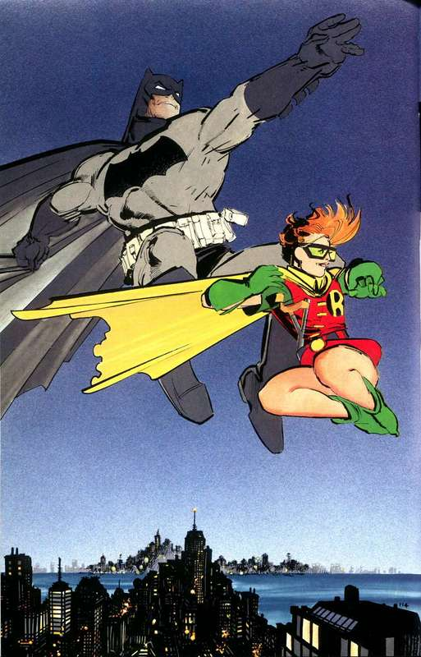
The Dark Knight Returns

Slide 12
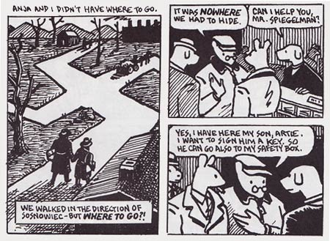
Maus

Slide 13
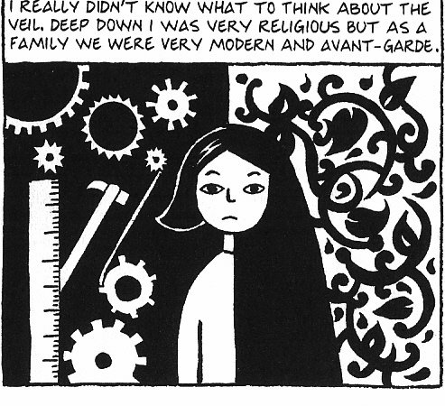
Persepolis

Slide 14
Lesson Examples: https://drive.google.com/drive/folders/0B-s4b2WcmYJFU1NKcjI1Z3I1cEk?usp=sharing
Offer choice in story telling:
Past or Future Autobiography
Adaptation of an existing song, book, or movie
Original Fiction
Create a “story board”
Number a paper from 1-20 and describe what will happen in each of your panels
Create a booklet to house your story
Three sheets of paper folded in half
Creates a Front Cover, Back Cover, and 10 inside pages
Minimum of two image panels per page

Slide 15
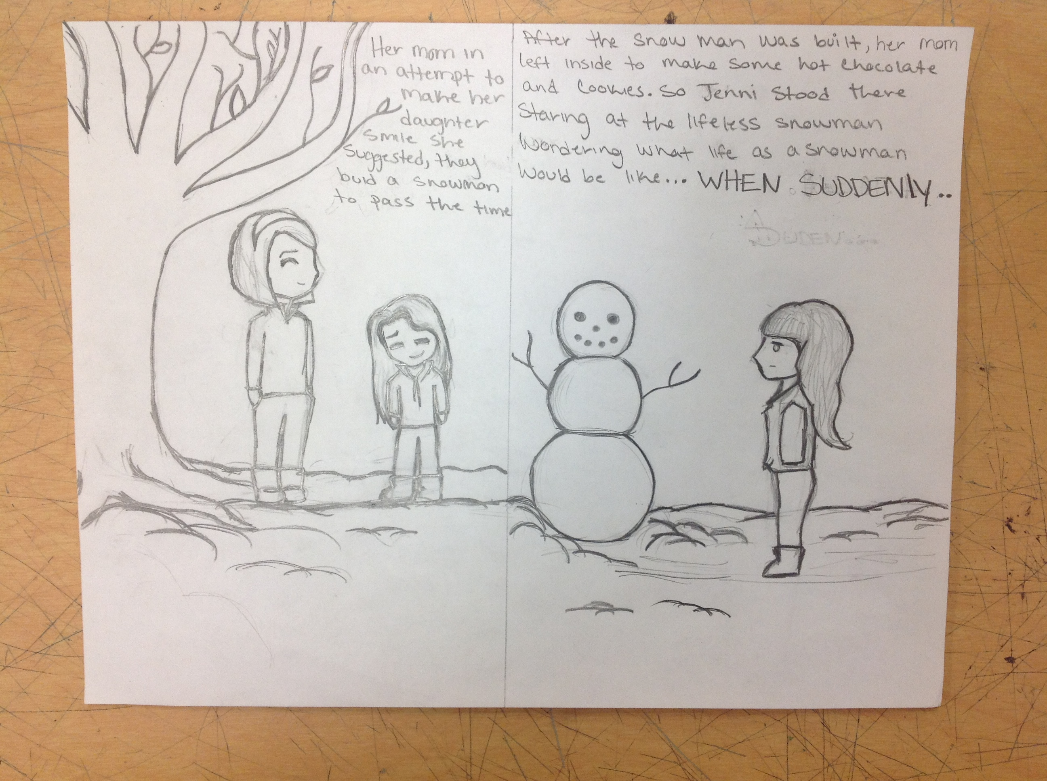
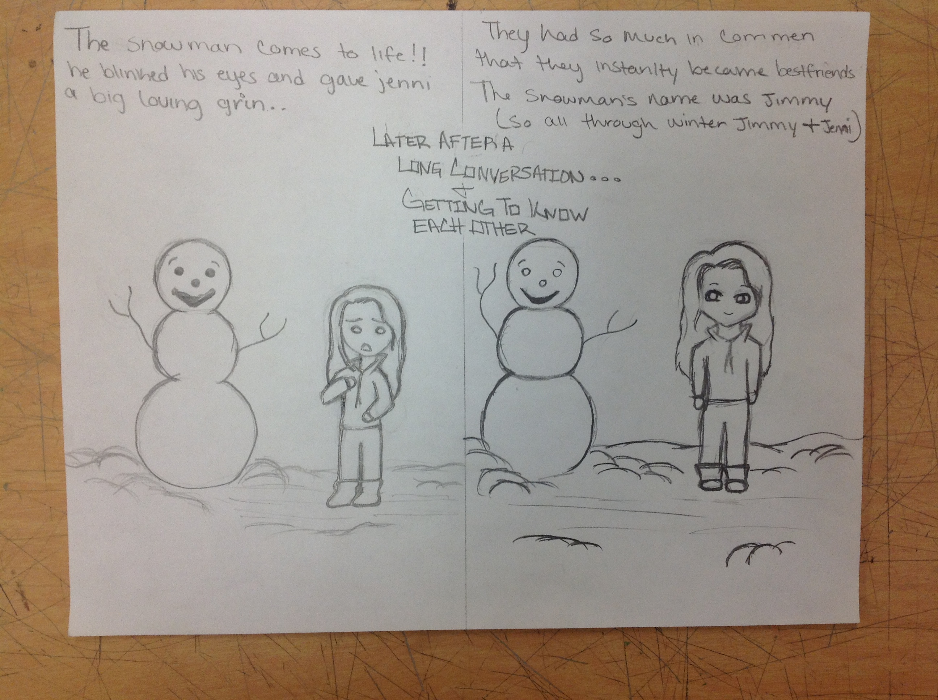
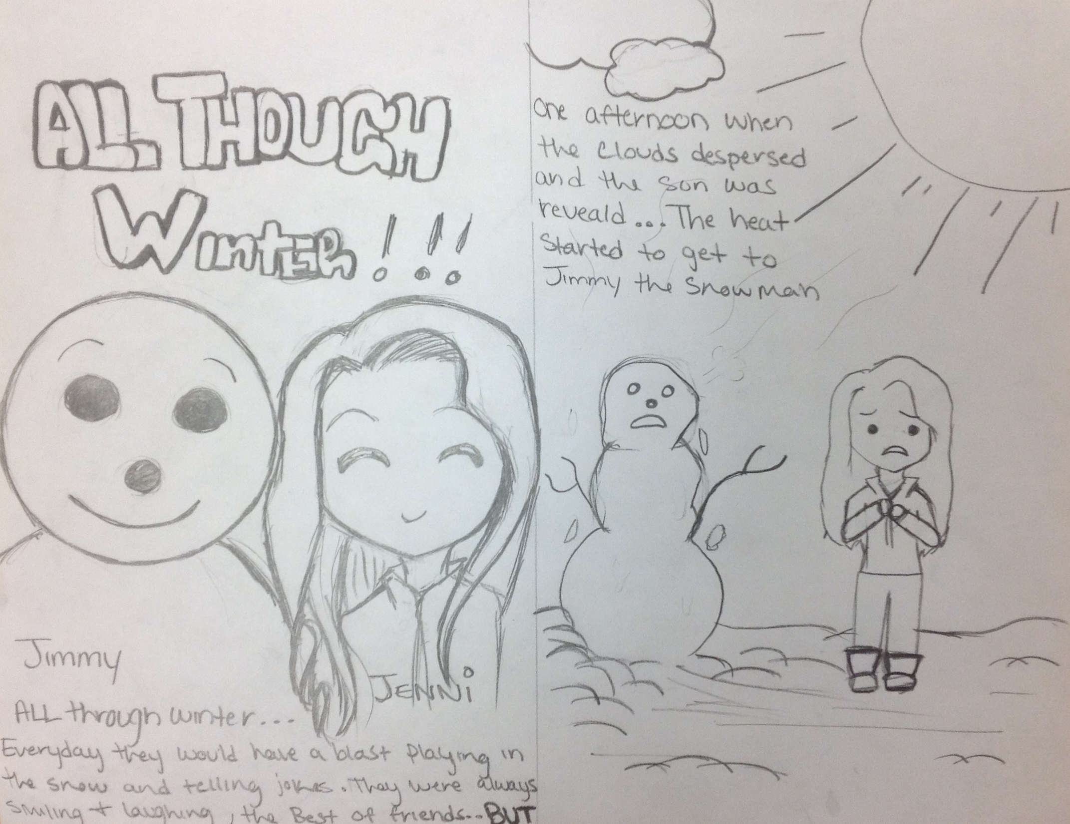
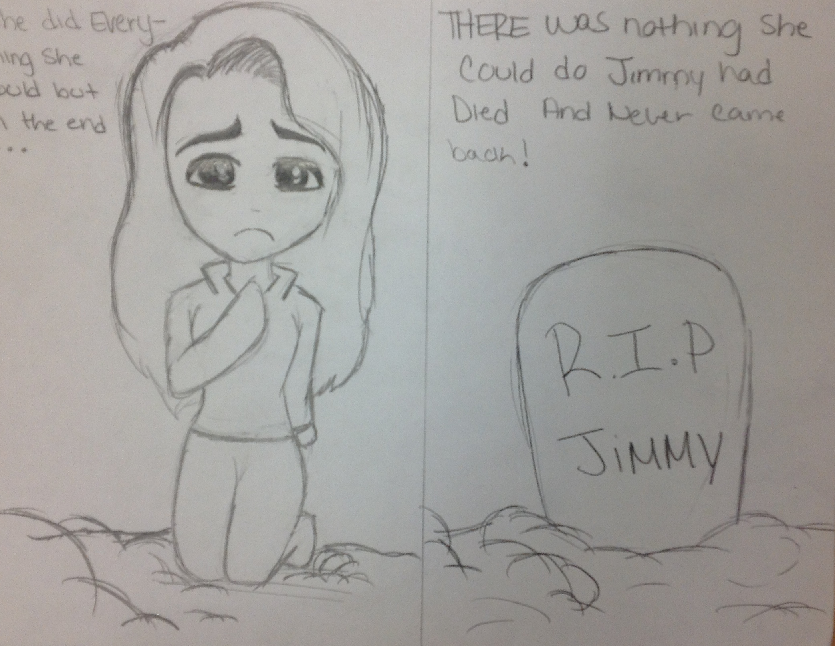
Student Work: Snow Day

Slide 16
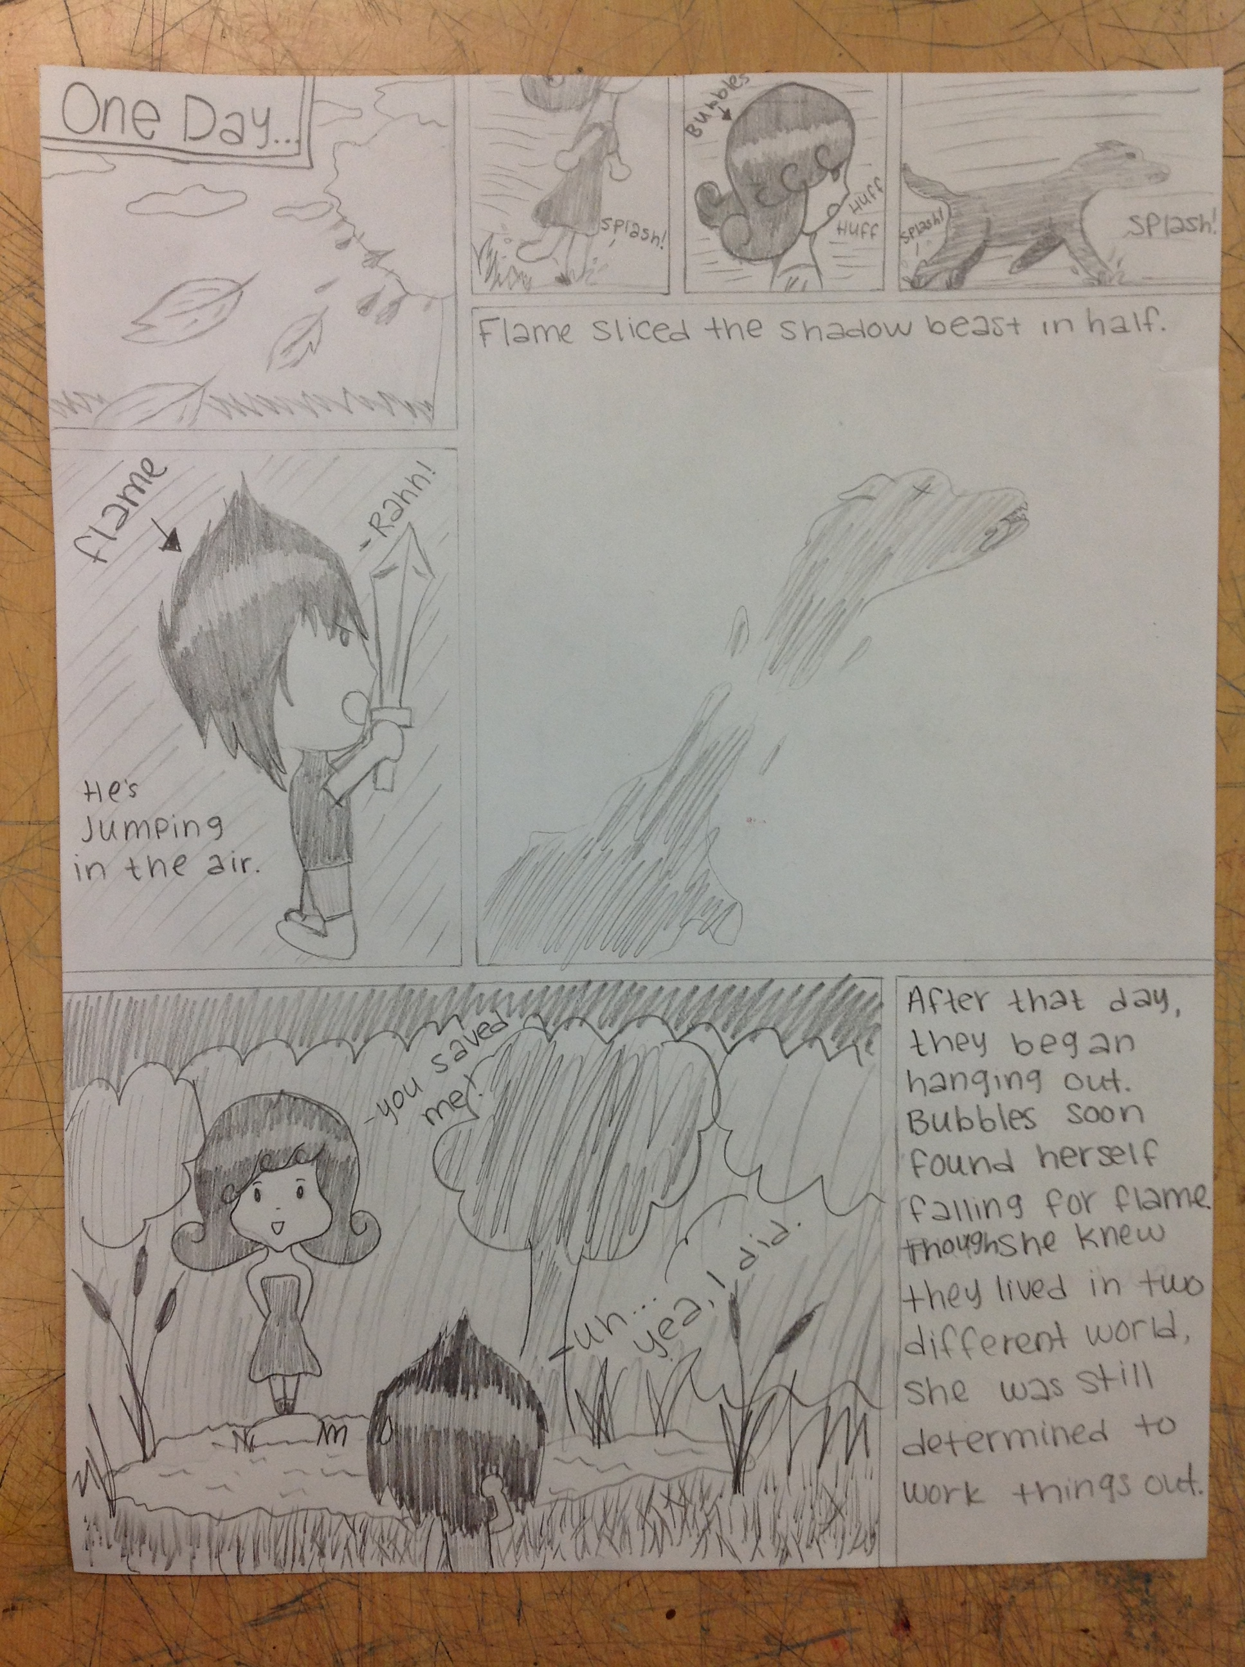
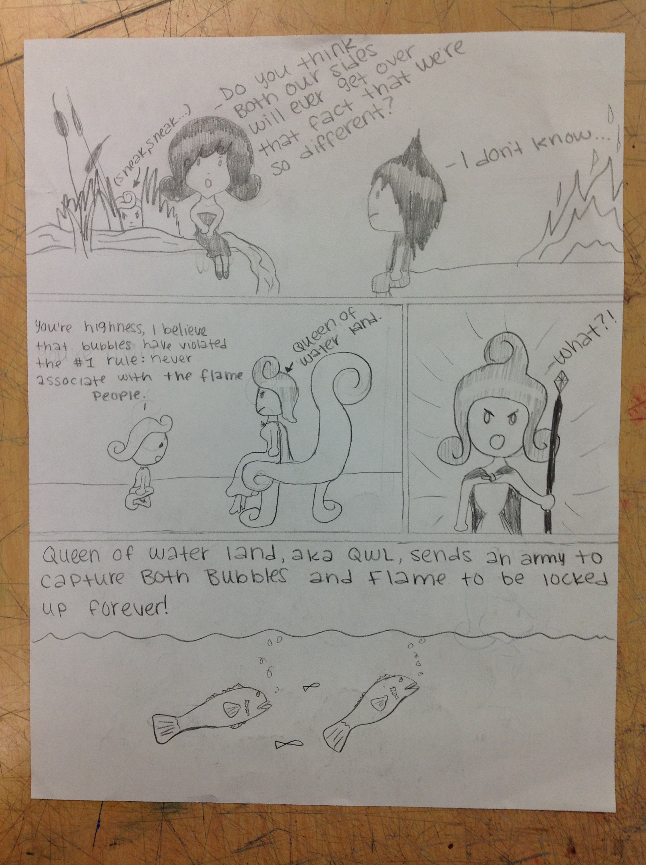
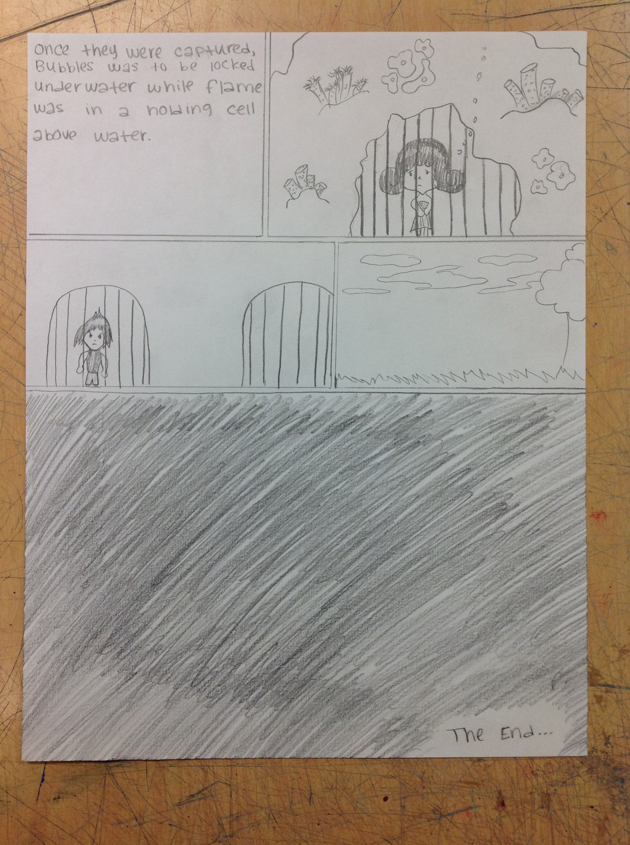
Student Work: Hot and Cold

Slide 17
Contact Info
Find me on Facebook! Randi Curtis or R.Michelle Art
Blog: Rmichelleclassroom.weebly.com
Email: R.michelleart@gmail.com

Slide 18
Works Cited
Burton, J. M. (2009). Creative Intelligence, Creative Practice: Lowenfeld Redux. Studies in Art Education, 50(4), p. 323-337.
Freedman, K. (2003). The Importance of Student Artistic Production to Teaching Visual Culture. Art Education, 56(2), p. 38-43.
Graham, M. A. (2003). Responding to the Demise of Adolescent Artmaking: Charting the Course of Adolescent Development in an Exceptional Art Classroom. Studies in Art Education, 44(2), p. 162-177.
Sousanis, N. (2012). The Shape of Our Thoughts: A Meditation On and In Comics. Visual Arts Research, 38(1), p. 1-10.
Tychinski, S. (2015). A Brief History of the Graphic Novel. Diamond Comic Distributors. Retrieved from http://www.diamondbookshelf.com/Home/1/1/20/164?articleID=64513.

